Slide 1


BrandFlow
Revolutionizing Business Operations with AI-Powered Solutions
Welcome to BrandFlow – where integrated solutions meet intelligent automation.

Slide 2
Created By
NAME : KUMAWAT NISHIT DUSHYENT
ROLL NO : 26
ENROLLMENT NO : 23002170110072
DIV : A1
BRANCH : CE

Slide 3
Business Ecosystem
In today's dynamic business landscape, scattered tools create inefficiencies. BrandFlow addresses this by providing a comprehensive, full-stack platform that seamlessly integrates critical business functions into one intuitive dashboard.
Client Management
Employee & Task Tracking
Streamline client interactions and relationship building.
Optimize team collaboration and project execution.
Document Handling
Budget & Expenses
Securely manage and share all essential documents.
Budget and expense module to manage the salaries and project expenses

Slide 4
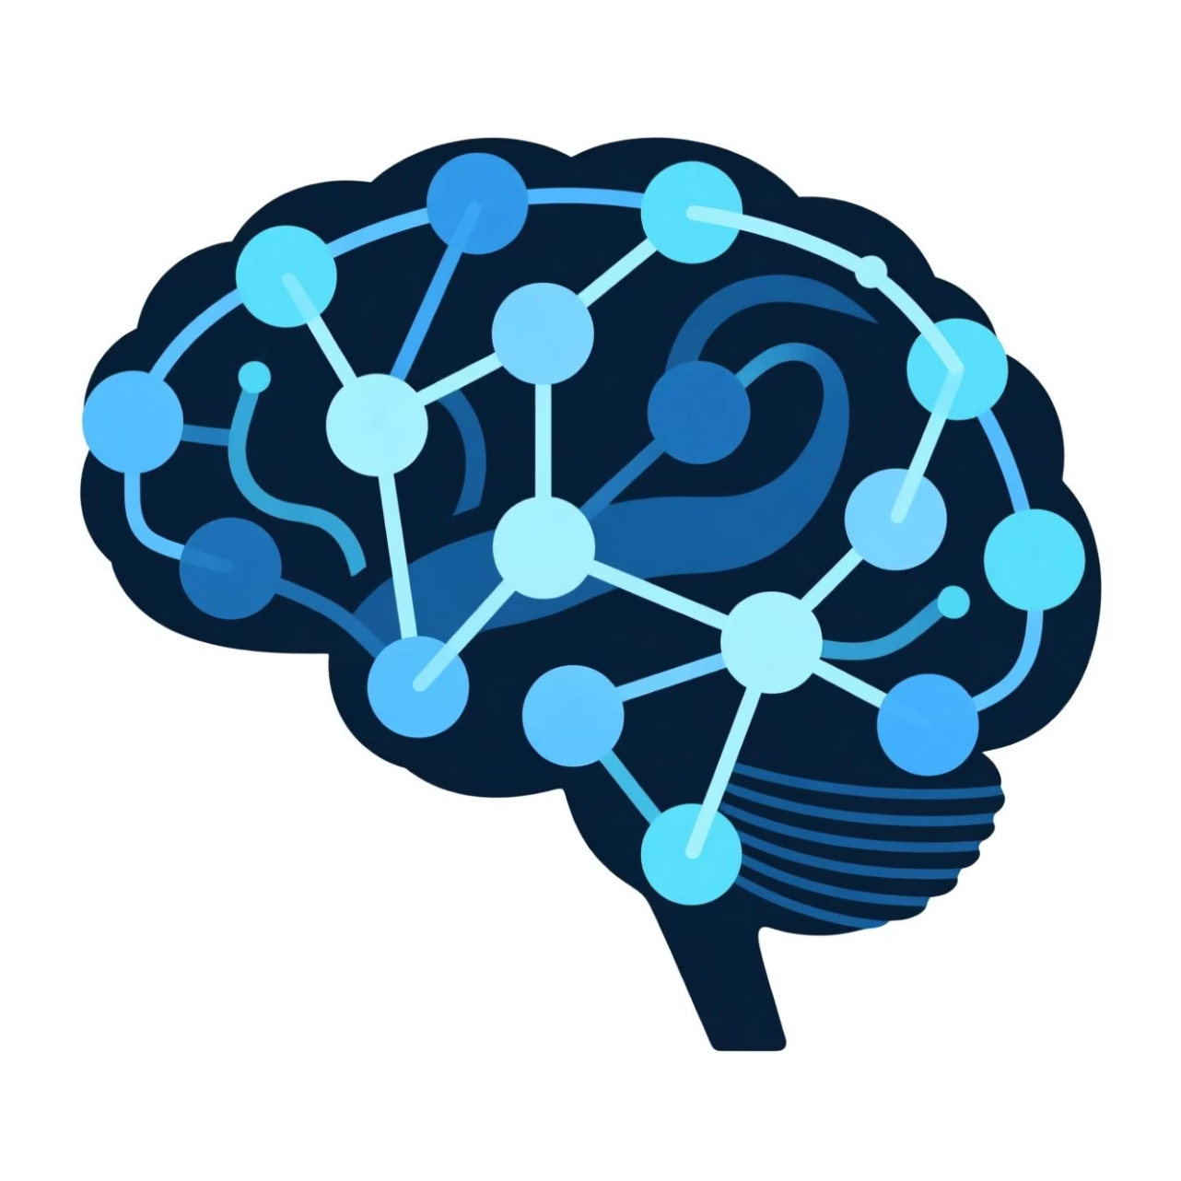
AI Integration with Gemini AI and Clipdrop
Gemini AI → Intelligent text analysis, decision support, and automation.
Clipdrop AI → Image generation and processing.
Automated Workflows: Reduce manual effort in creating checkpoints.
Personalized Experiences: Chatbot for helping user .
Effortless Image Generation: Quickly create custom marketing campaigns

Slide 5
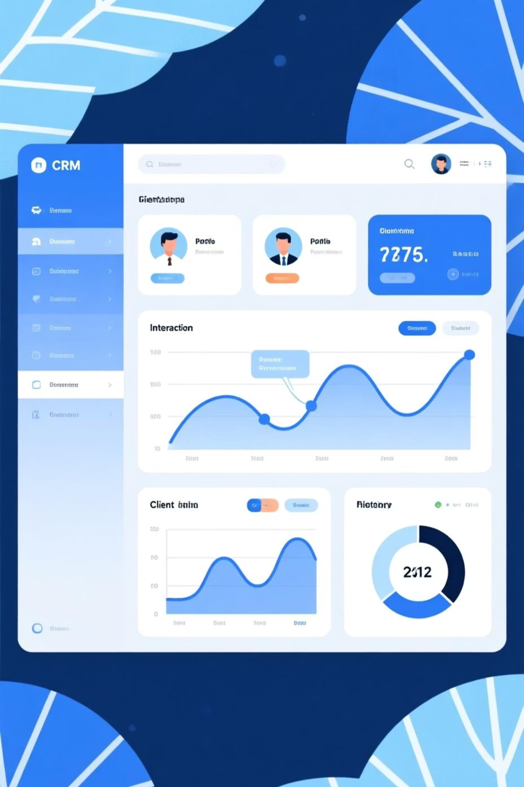
Core Feature: Employee & Client Management
BrandFlow provides a robust suite of tools to manage your most valuable asset: your clients. From adding employees and creating team and provide regulare updates
Centralized Records
1
All client data in one secure location.
Assign Team Leads
2
Team leader for managing the team
Relationship History
3
Understand client journeys and preferences.

Slide 6
Dynamic Team & Task Management
Empower your workforce with BrandFlow's intuitive tools for team collaboration and task assignment. Boost productivity and ensure projects stay on track.
01
02
Create Teams
Assign Tasks
Organize employees into functional groups.
Clearly assign tasks to the teams
03
04
Track Progress
Communication with Employee
Monitor task completion and project milestones.
Facilitate seamless communication within teams.

Slide 7
Under the Hood: Robust Tech Stack
BrandFlow is built on a foundation of modern, scalable technologies, ensuring reliability, performance, and future adaptability.
Frontend
Backend
AI & Others
React.js: Dynamic and responsive user interfaces.
Django (Python): Secure and powerful web framework.
Gemini AI: Core intelligence for text and workflows.
Tailwind CSS: Rapid, utility-first styling.
Django REST Framework: Robust API development.
Clipdrop AI: Advanced image generation and processing.
Framer Motion: Smooth animations for enhanced UX.
Axios: Efficient HTTP client for data fetching.
Lucide Icons: Crisp, scalable iconography.

Slide 8
THANK YOU!!

